Slide 1

AGB1211 – DESIGN THINKING
Department of Artificial Intelligence and Data Science
Academic Year: 2024 – 2025 (Odd Semester)
Year :II
Semester :III
Section :B
Date :06.12.2024
PRESENTED BY, GUIDED BY
1.NANDHINI.K(2303811724322075) JOANY FRANKLIN M.E.,
2.NEKA SHRI.S(2303811724322076) Assistant Professor,
3.NITHYAPRIYA.S(2303811724322078) Department of AI,
4.PADMA PRIYA.S(2303811724322080) K.Ramakrishnan College ofTechnology.

Slide 2

Title of the Project
SAFETY AND SERVICES
IN INSTITUTE

Slide 3
Problem Identification
Accessibility Challenges
Service-Related Issues
User Experience Challenges
High Cost of Implementation
Lack of Awareness: Students and staff may not be fully informed about available safety measures and services.
Over-Complex Systems: Safety and service tools might be difficult to navigate for some users

Slide 4
Objective
Secure Environment: Ensure safety through robust security measures, health promotion, and effective risk mitigation.
Efficient Services: Provide accessible, responsive, and efficient services to meet the needs of students, staff, and visitors.
Continuous Improvement: Focus on transparency, sustainability, and ongoing enhancements to create a positive experience for the entire community.

Slide 5
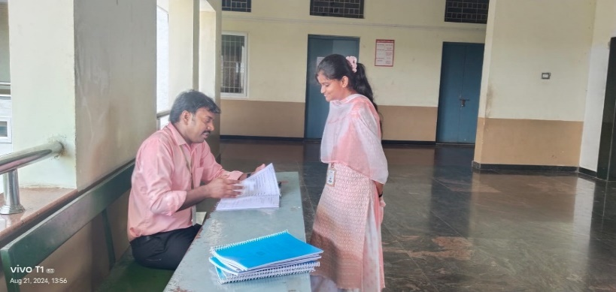
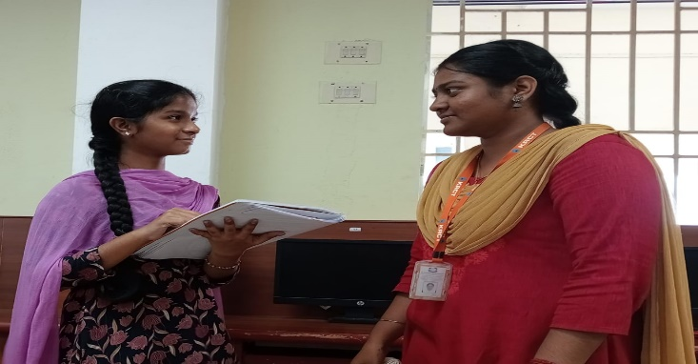
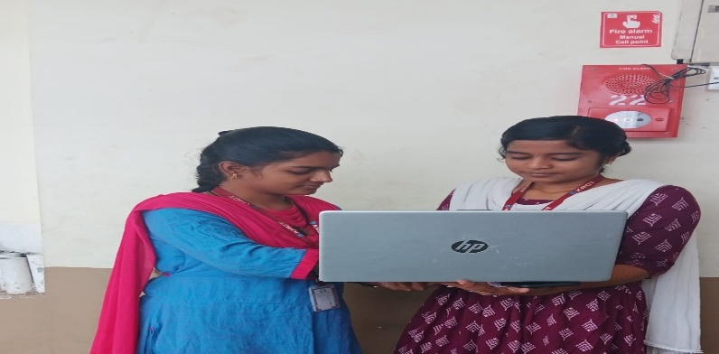
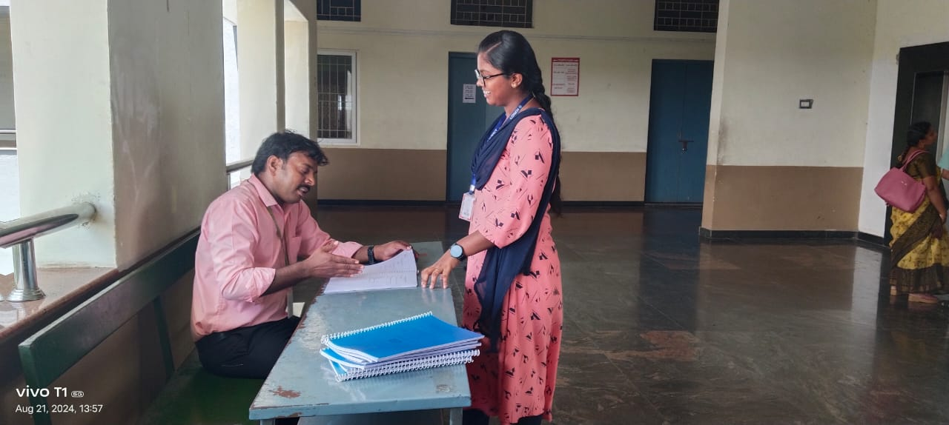
BrainStorming

Slide 6
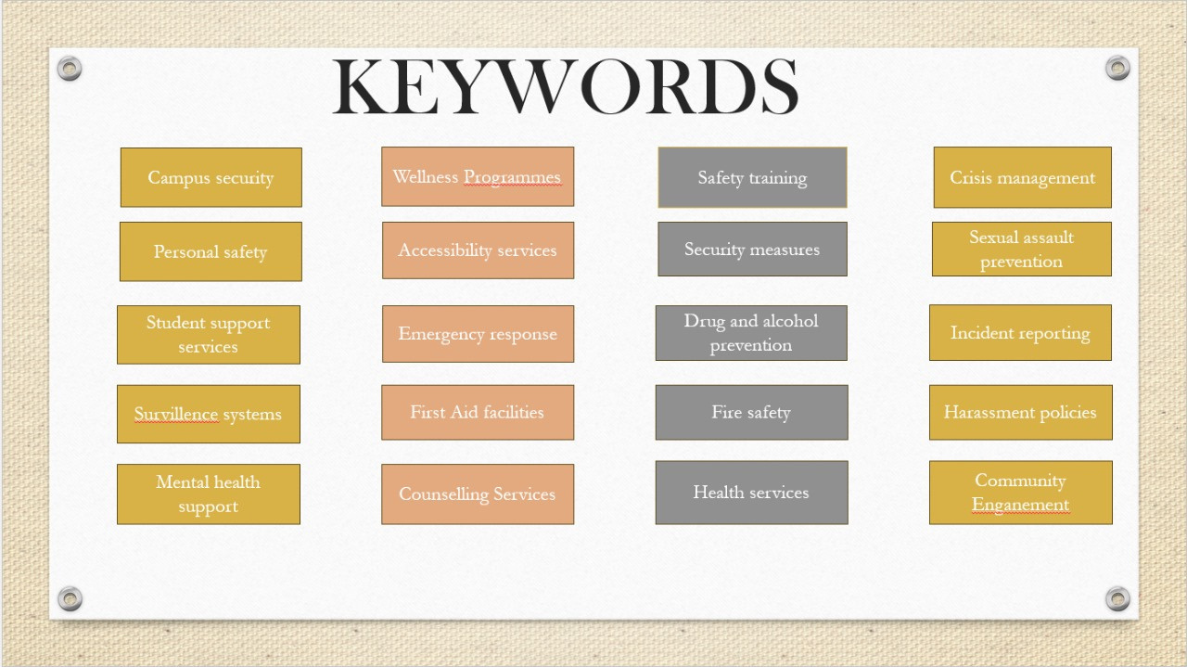
BrainStorming

Slide 7
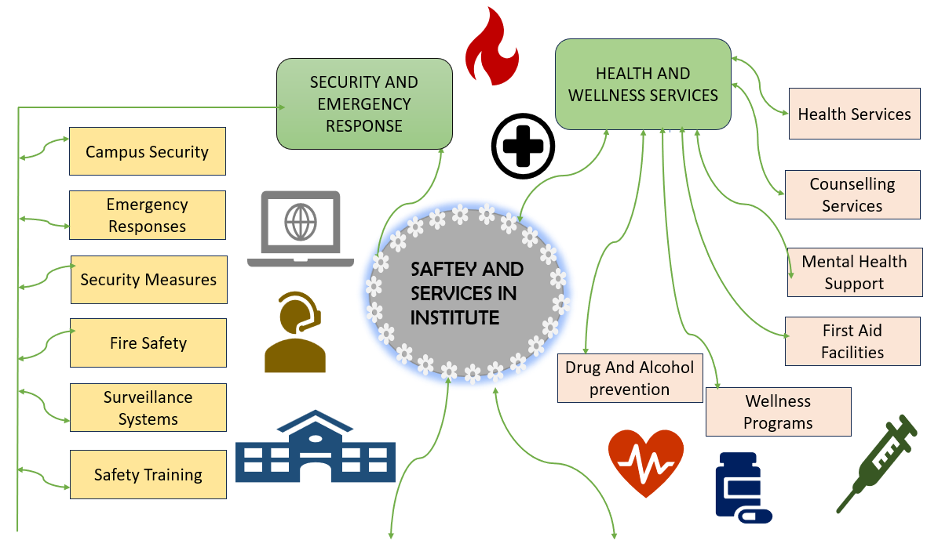
Mind Map

Slide 8
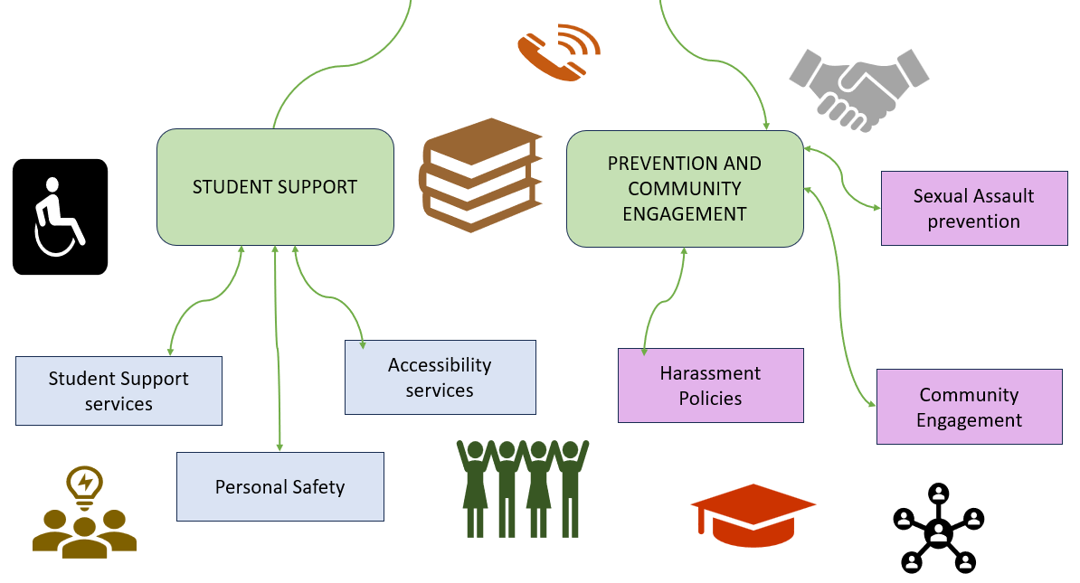
Mind Map

Slide 9
Primary Research
1.Surveys and Questionnaires:
Target Audience: Students, educators, parents, and administrators.
Key Questions: What safety concerns or challenges do you face in the institute?
2.Focus Groups
Organize sessions with small groups of students, teachers.
Topics for discussion: Benefits and concerns about VR in education

Slide 10
Secondary Research
1. Market Analysis
Study market trends, growth, and leading competitors in safety and service solutions for educational institutions. Analyze their strengths and weaknesses to identify opportunities for improvement.
2. Research Studies
Review studies on the effectiveness of safety measures and service systems, focusing on their impact on institutional operations and user satisfaction.
3. Industry Reports
understand trends in technological adoption and operational efficiency in education.

Slide 11
Proposed Work
Integrated Safety Systems:
Advanced sensors monitor real-time safety conditions, ensuring a secure campus environment.
Mobile App Integration:
A user-friendly app provides live updates on safety alerts, service availability, and campus facilities.
Maintenance Notifications:
Automated alerts ensure timely upkeep of safety equipment and service systems.

Slide 12
List of Modules
Data Storage Module
Admin Dashboard Module
User Management Module

Slide 13
Module 1 Description
1. Data Storage Module
Purpose: To store and manage all app-related data securely.
Key Features:
User Data: Store user profiles, roles, and credentials (securely encrypted).
Backup System: Ensure regular backups to prevent data loss.
Technology Suggestions for Database:
Use Firebase Realtime Database, SQLite, or MongoDB for cloud or local storage.

Slide 14
Module 2 Description
2. Admin Dashboard Module
Purpose: To provide administrators with tools to manage the app and users.
Key Features:
Monitor Activity: View reports, bookings, and complaints.
Incident Management: Track SOS alerts and ensure timely response.
Approve/Reject Requests: Handle room bookings and service complaints.
Analytics: Access data visualizations to evaluate app performance

Slide 15
Module 3 Description (Cont..)
3.User Management Module
Purpose: To provide administrators with tools to manage user accounts and their activities effectively.
Key Features:
User Profiles Management: View and update user details, roles, and account statuses.
Account Control: Activate, deactivate, or suspend user accounts as required.
Activity Tracking: Monitor user actions and access detailed activity logs for transparency.
Notifications and Alerts: Stay updated on critical activities and pending tasks through real-time alerts.

Slide 16

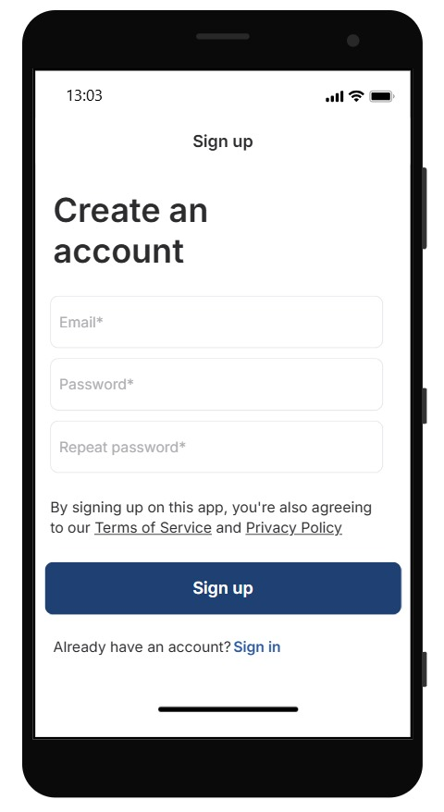
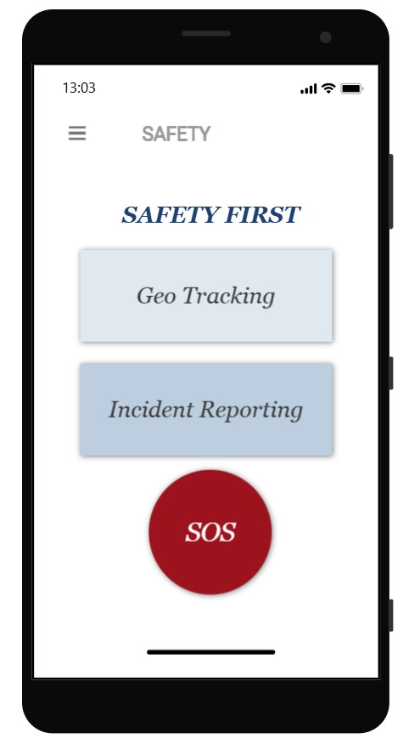
Results

Slide 17
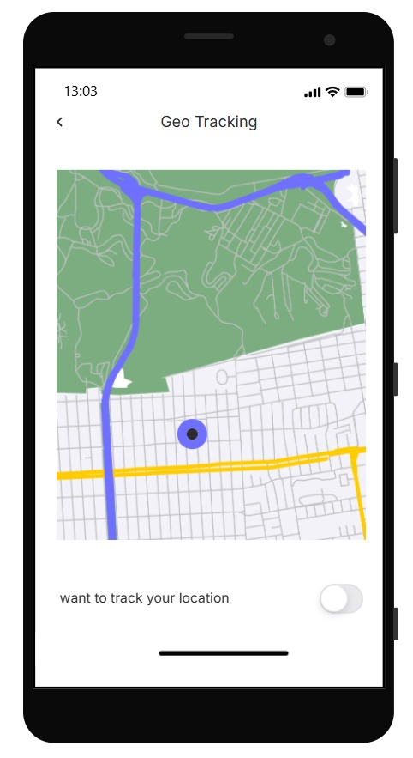
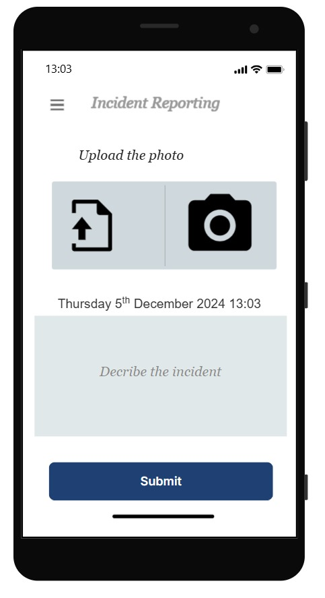
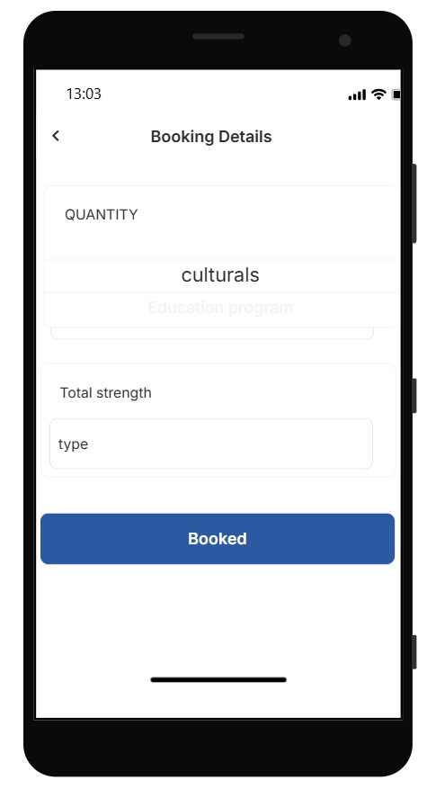
Results

Slide 18
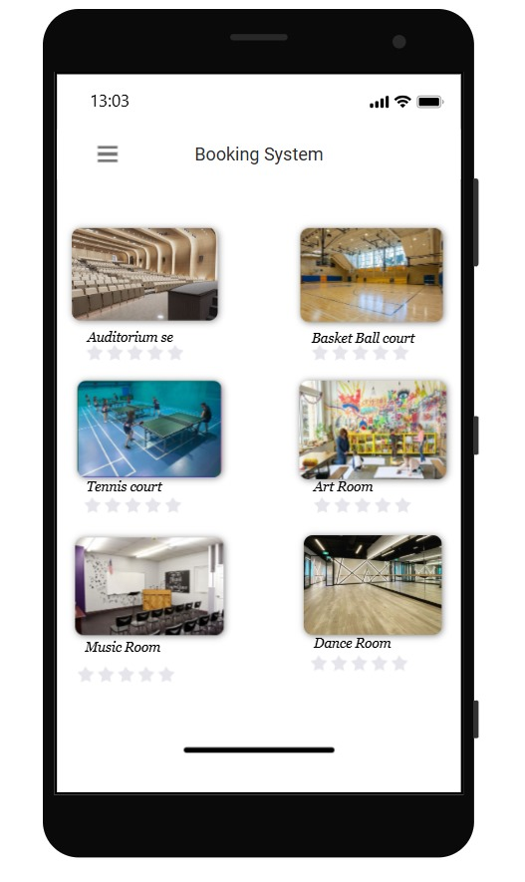
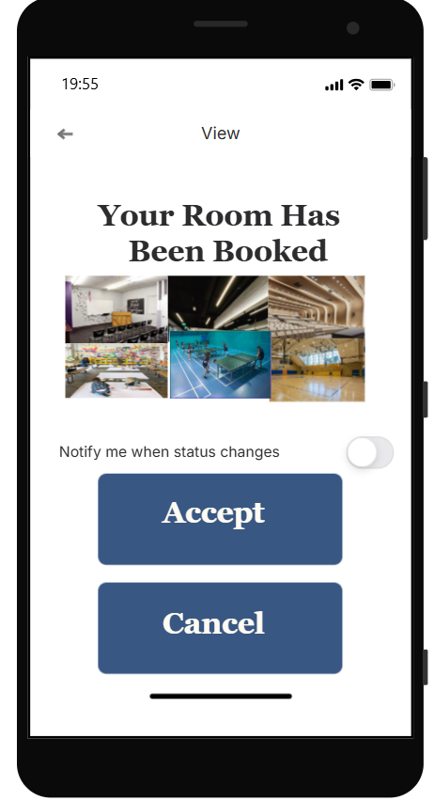
Results

Slide 19
Conclusion
The Safety and Services in Institutes app aims to:
Revolutionize campus experiences.
Ensure a secure and well-organized environment.
Ensures a secure and well-organized environment in institutes by leveraging advanced technology.
Streamlines essential services to enhance convenience for students, staff, and visitors.
Focuses on user-centric design and seamless functionality to set the stage for future advancements

Slide 20
Thank You
Any queries???

